Slide 1

Department of Electrical and Electronics Engineering
Internship presentation
on
RENEWABLE ENERGY SOURCES AND
GRID INTEGRATION
Presented By
D.Madhuthrisha
18WJ1A0225
EEE -1
HEAD OF THE DEPARTMENT
Dr K.Santhi

Slide 2
Contents
Introduction
Types of Energy Sources
Solar Photo-Voltaic Cell
Grid connected overview
Wind Energy
Solar PV AC Power Control System
Simulink Model

Slide 3
INTRODUCTION
Energy is one of the major inputs for the economic development of any country. In the case of the developing countries, the energy sector assumes a critical importance in view of the ever increasing energy needs requiring huge investments to meet them.

Slide 4
Types of Energy Sources
Energy can be classified into several types based on the following criteria:
Primary and Secondary energy
Commercial and Non-commercial energy
Renewable and Non-Renewable energy

Slide 5
Primary and Secondary Energy
Primary energy sources are those that are either found or stored in nature. Common primary energy sources are coal, oil, natural gas, and biomass (such as wood). Other primary energy sources available include nuclear energy from radioactive substances, thermal energy stored in earth's interior, and potential energy due to earth's gravity. Primary energy sources are mostly converted in industrial utilities into secondary energy sources; for example, coal, oil or gas converted into steam and electricity. Primary energy can also be used directly. Some energy sources have non-energy uses, for example coal or natural gas can be used as a feedstock in fertiliser plants.

Slide 6
Commercial Energy and Non-Commercial Energy
Commercial Energy: The energy sources that are available in the market for a definite price are known as commercial energy. By far the most important forms of commercial energy are electricity, coal and refined petroleum products. Commercial energy forms the basis of industrial, agricultural, transport and commercial development in the modern world. In the industrialized countries, commercialized fuels are predominant source not only for economic production, but also for many household tasks of general population. Examples: Electricity, lignite, coal, oil, natural gas etc.

Slide 7
Non-Commercial Energy The energy sources that are not available in the commercial market for a price are classified as noncommercial energy. Non-commercial energy sources include fuels such as firewood, cattle dung and agricultural wastes, which are traditionally gathered, and not bought at a price used especially in rural households. These are also called traditional fuels. Non-commercial energy is often ignored in energy accounting. Example: Firewood, agro waste in rural areas; solar energy for water heating, electricity generation, for drying grain, fish and fruits; animal power for transport, threshing, lifting water for irrigation, crushing sugarcane; wind energy for lifting water and electricity generation.

Slide 8
Renewable and Non-Renewable Energy
Renewable energy is energy obtained from sources that are essentially inexhaustible. Examples of renewable resources include wind power, solar power, geothermal energy, tidal power and hydroelectric power (See Figure 1.2). The most important feature of renewable energy is that it can be harnessed without the release of harmful pollutants. Non-renewable energy is the conventional fossil fuels such as coal, oil and gas, which are likely to deplete with time.

Slide 9
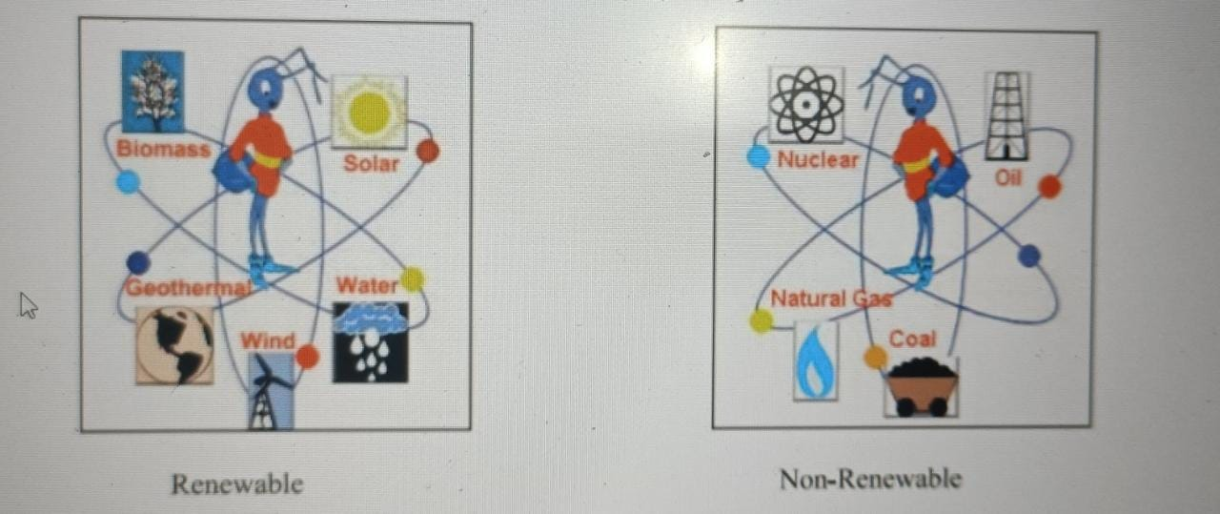

Slide 10
Solar Energy Scenario in India
The Sun has been worshiped as a life-giver to our planet since ancient times. The industrial ages gave us the understanding of sunlight as an energy source. India is endowed with vast solar energy potential. About 5,000 trillion kWh per year energy is incident over India's land area with most parts receiving 4-7 kWh per sq. m per day. Solar also provides the ability to generate power on a distributed basis and enables rapid capacity addition with short lead times. Off-grid decentralized and low temperature applications will be advantageous from a rural electrification perspective and meeting other energy needs for power and heating and cooling in both rural and urban areas. From an energy security perspective, solar is the most secure of all sources, since it is abundantly available. Theoretically, a small fraction of the total incident solar energy (if captured effectively) can meet the entire country's power requirements.

Slide 11
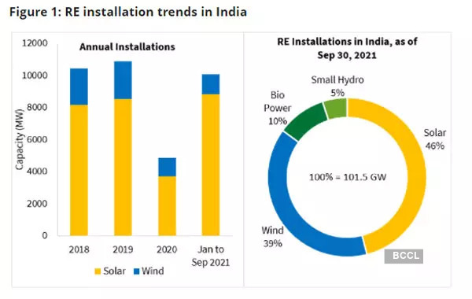

Slide 12
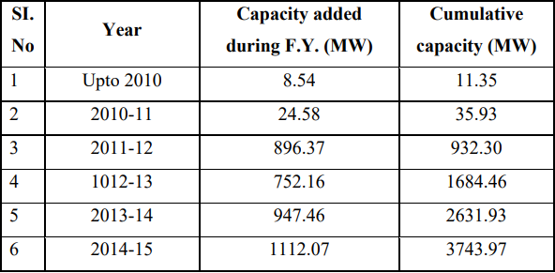
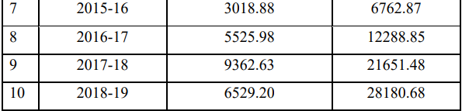
Grid Connected Overview:
Solar power sector in India has emerged as a fast upcoming section
in last few years.
It supports the government agenda of sustainable growth, while,
emerging as an integral part of the solution to meet the nation’s
energy needs and an essential player for energy security.

Slide 13
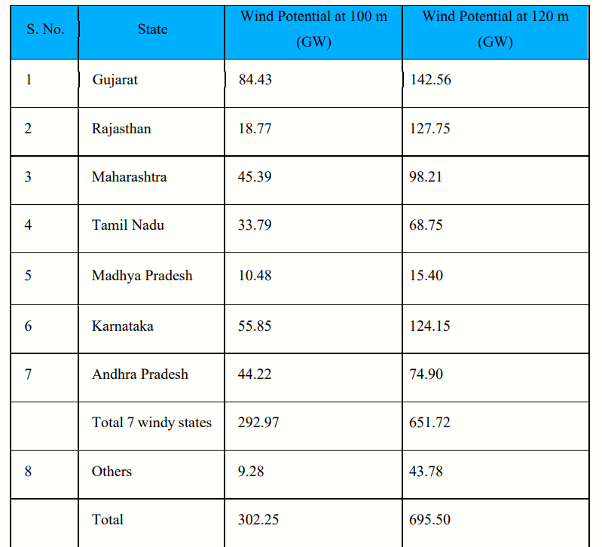
Wind Energy Scenario in India

Slide 14
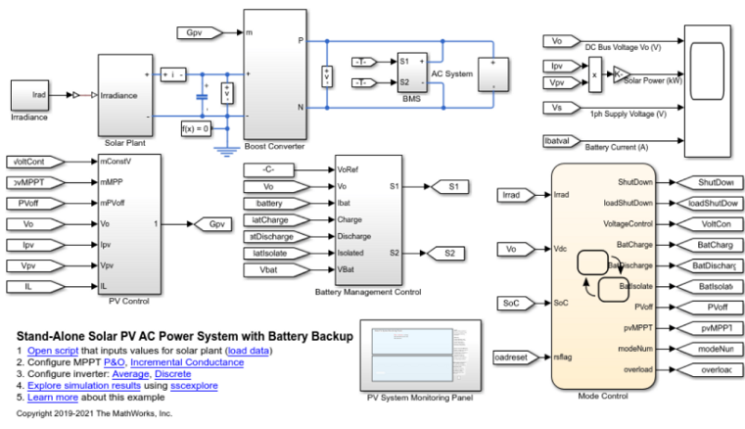
Solar PV AC Power Control System

Slide 15
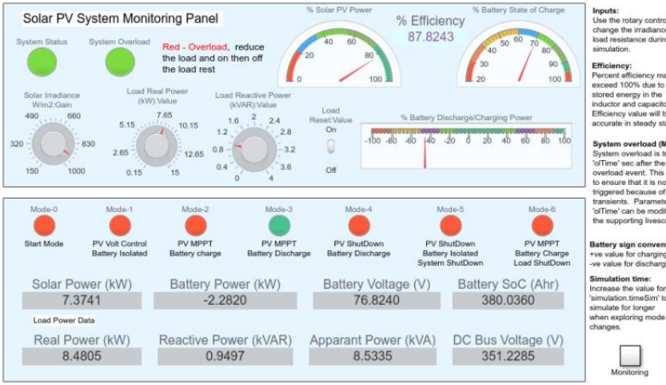
Simulink Model:

Slide 16
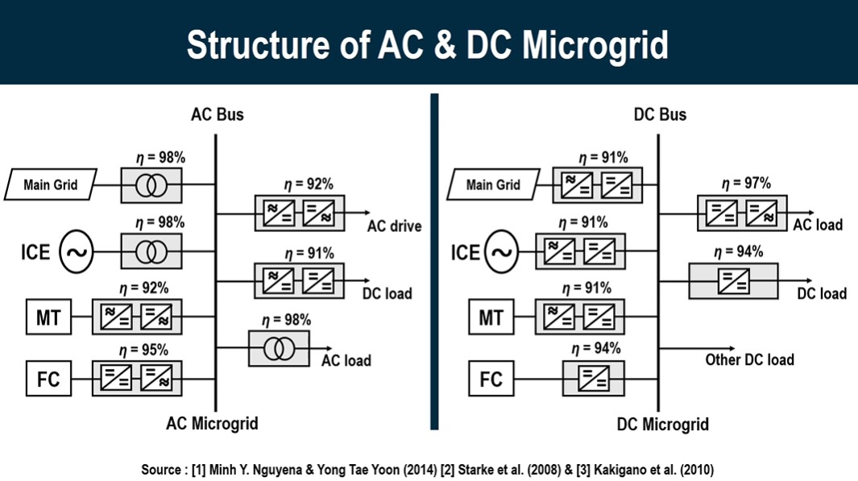
STRUCTURE OF AC & DC MICROGRID

Slide 17
Operating modes of the stand-alone PV AC System are:
• Mode-0 - Start mode (Default simulation starting mode)
• Mode-1 - PV in output voltage control, battery fully charged and isolated
• Mode-2 - PV in maximum power point, battery is charging
• Mode-3 - PV in maximum power point, battery is discharging
• Mode-4 - Night mode, PV shutdown, battery is discharging
• Mode-5 - Total system shutdown
• Mode-6 - PV in maximum power point, battery is charging, load is disconnected

Slide 18


